Slide 1
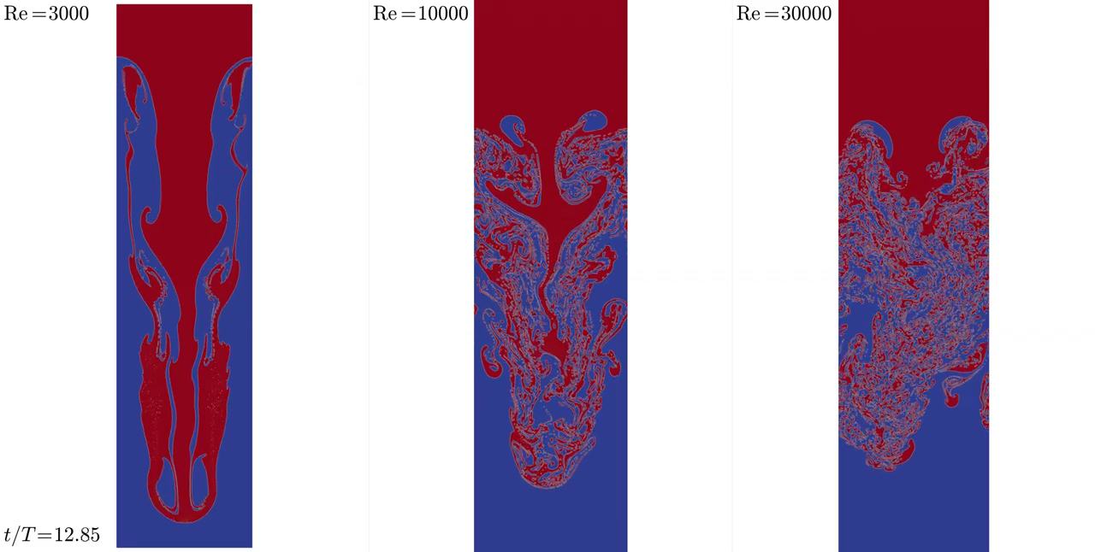
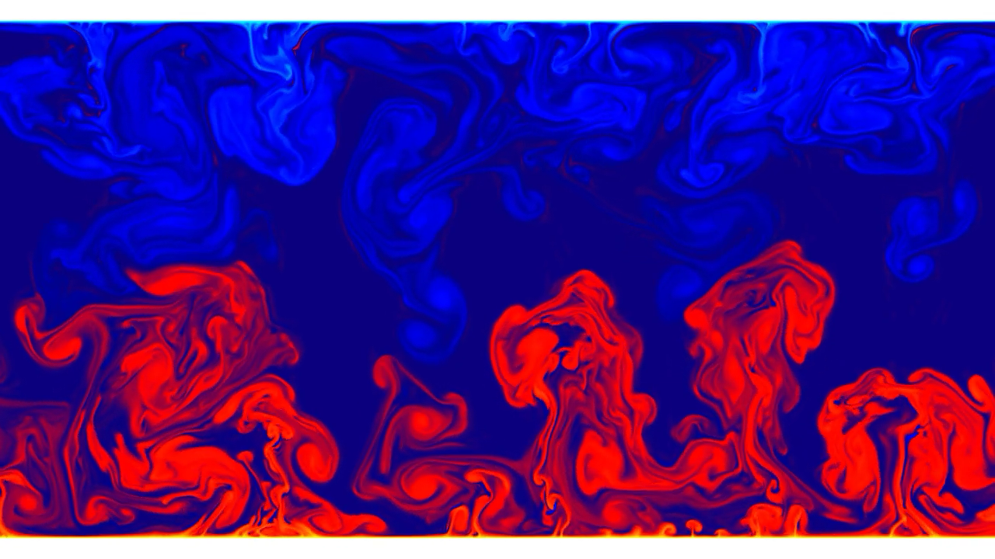
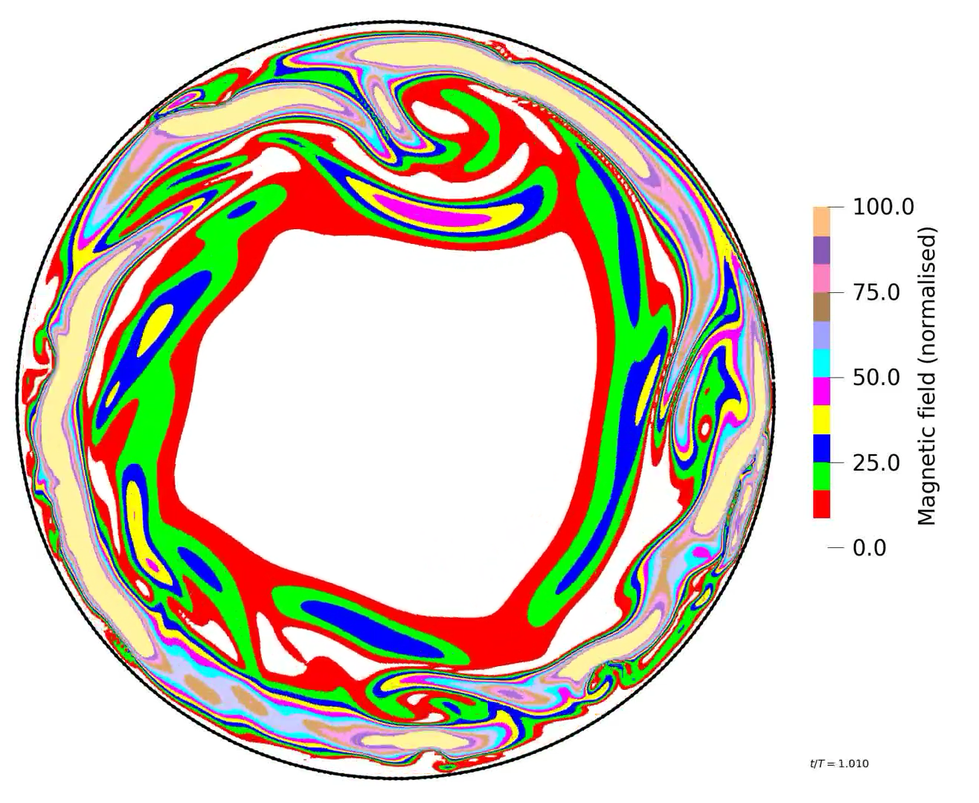
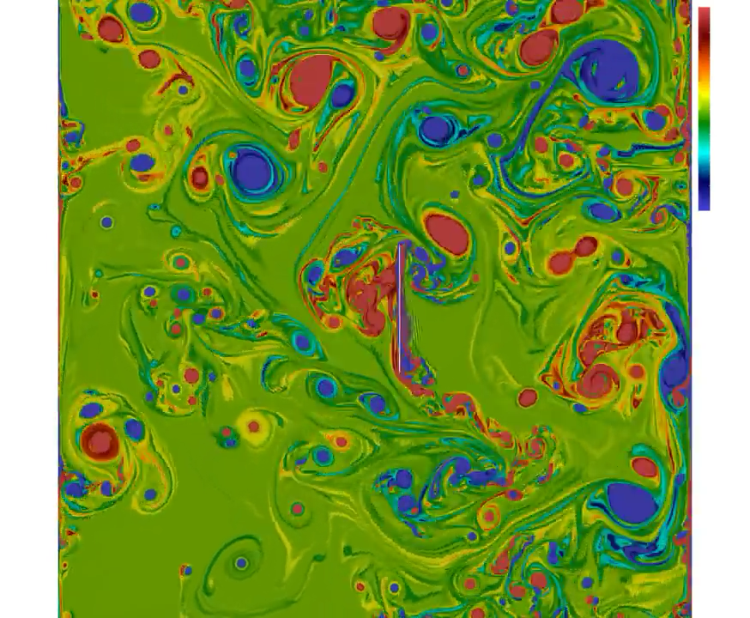


Fluid dynamics and beyond: opportunities with the lattice Boltzmann method
De Rosis & Enan
Phys Fluids 2021
Alessandro De Rosis
Lecturer in Virtual Engineering
Department of Fluids and Environment
The University of Manchester
alessandro.derosis@manchester.ac.uk
De Rosis
Europhys Lett 2018
Notes:
bhauhfuasd

Slide 2
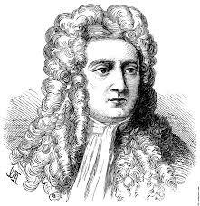
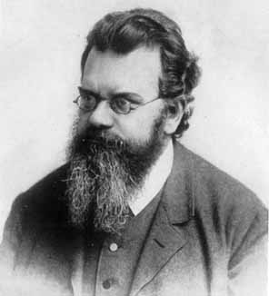
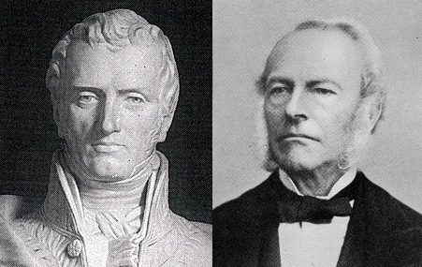
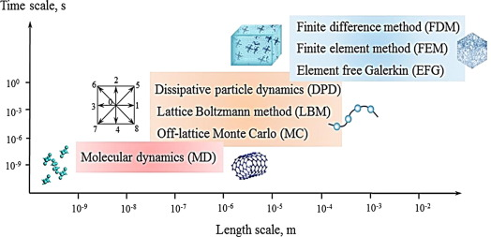
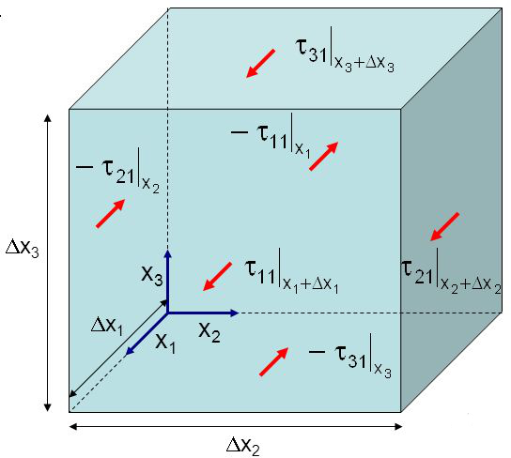
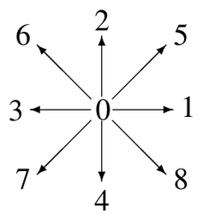
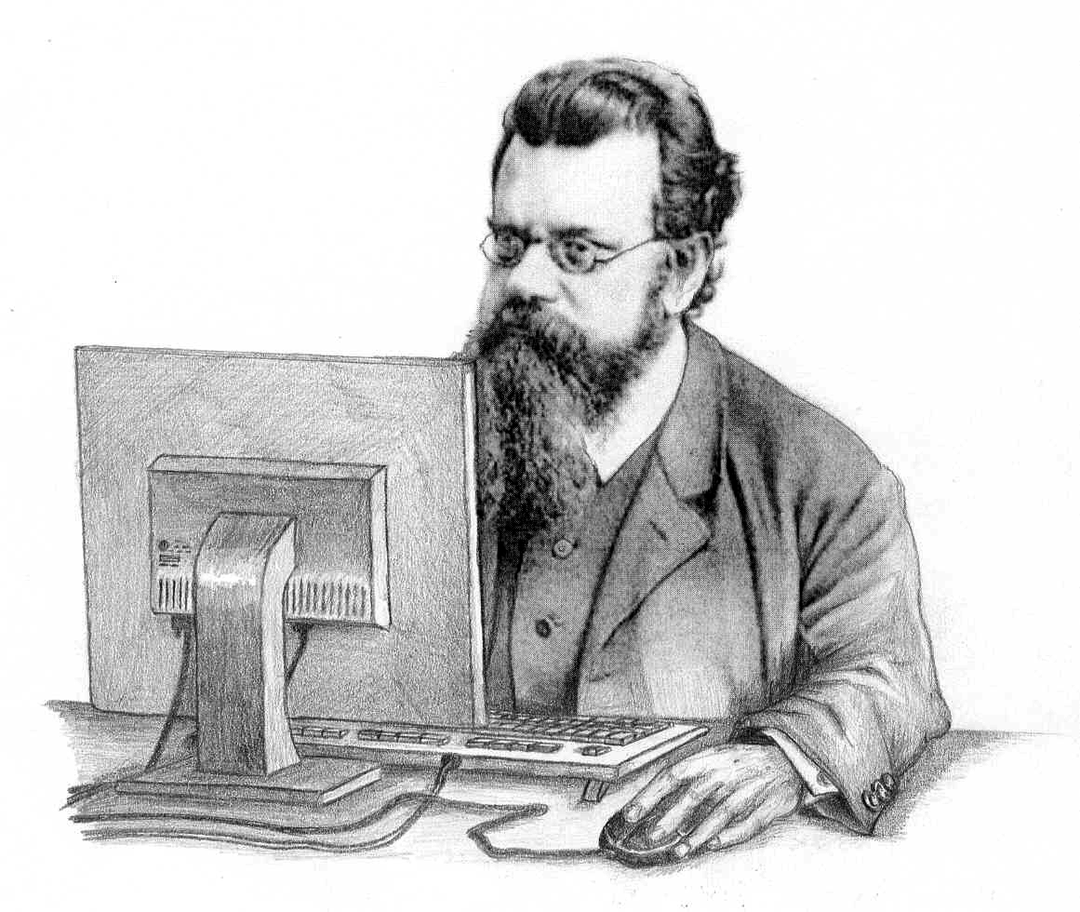
Numerical simulations of fluid dynamics
4
Microscopic
Kinetic
Macroscopic
Time scale [s]
Finite difference method
Finite volume method
Element free Galerkin
v
10⁰
Dissipative particle dynamics
Lattice Boltzmann method (LBM)
Off-lattice Monte Carlo
10⁻³
10⁻⁶
10⁻⁹
Molecular dynamics
v
10⁻⁹
10⁻⁸
10⁻⁷
10⁻⁶
10⁻⁵
10⁻⁴
10⁻³
10⁻²
Length scale [m]
The 10-orders-of-magnitude hierarchy

Slide 3
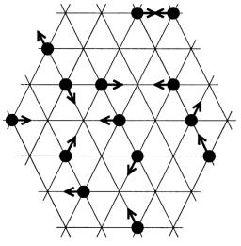
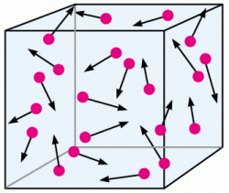
Lattice Boltzmann method
5
Lattice
Boltzmann
(Kinetic theory)

Slide 4
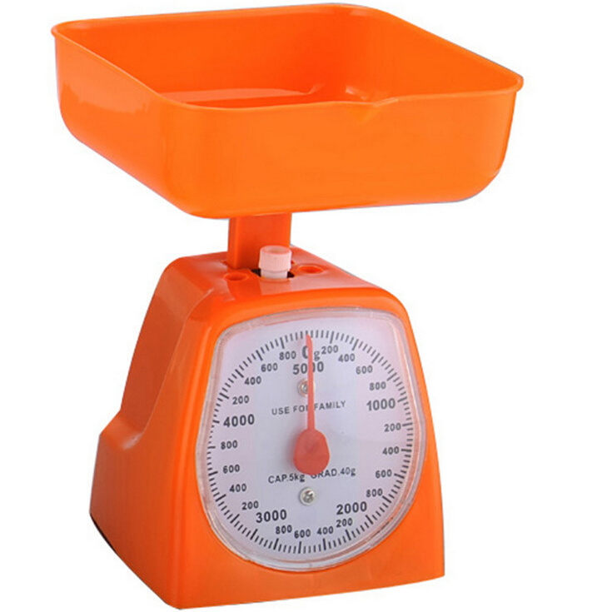
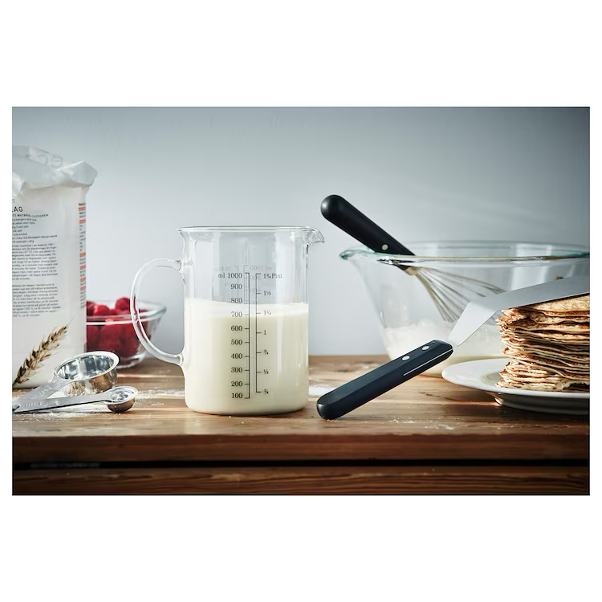
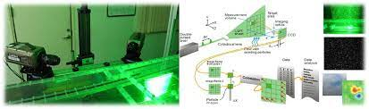
Linking macro and micro worlds
6
Macroscopic and microscopic scales
At the macroscopic level, a fluid is a continuous material with some properties and it obeys the Navier-Stokes equations. Pressure, density and velocity are continuous variables which can be measured.

Slide 5
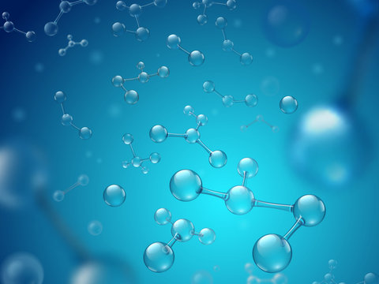
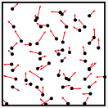
Linking macro and micro worlds
7
Macroscopic and microscopic scales
At the microscopic level, we play another game. Here, the fluid is an ensemble of molecules with an unpredictable (chaotic) behaviour and it loses its apparent global coherence. The apparent continuity of the fluid is broken.
Establishing the link between macro and micro worlds is instrumental to a better understanding of the fluid behaviour.

Slide 6
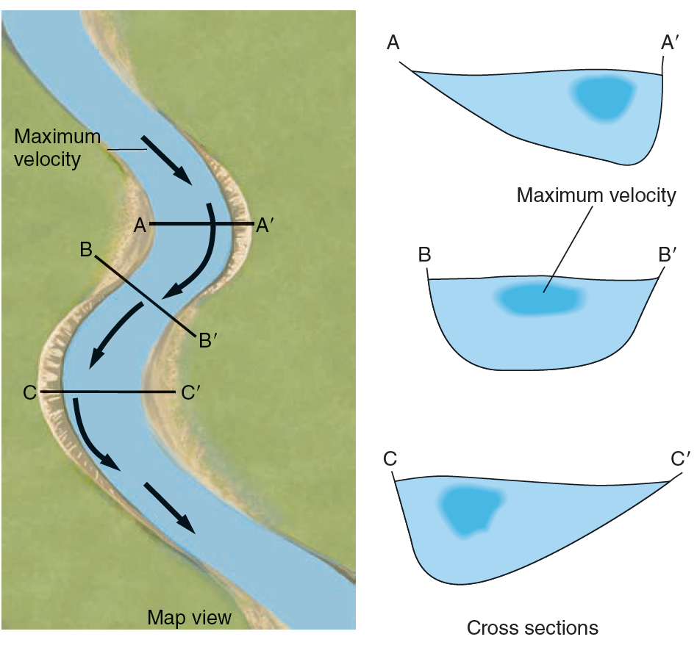
Linking macro and micro worlds
8
Macroscopic and microscopic scales
At the macroscopic level, we can visualise and measure density and velocity.
At the microscopic level, how can we define density and velocity while molecules move in a disordered way?

Slide 7
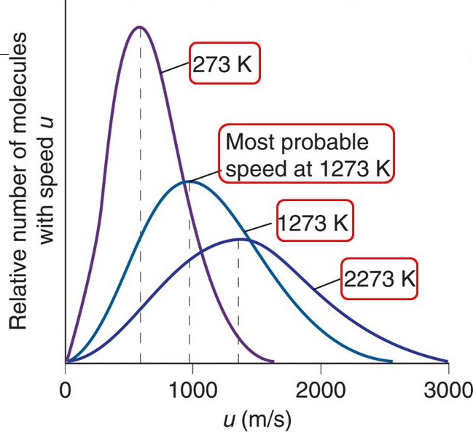
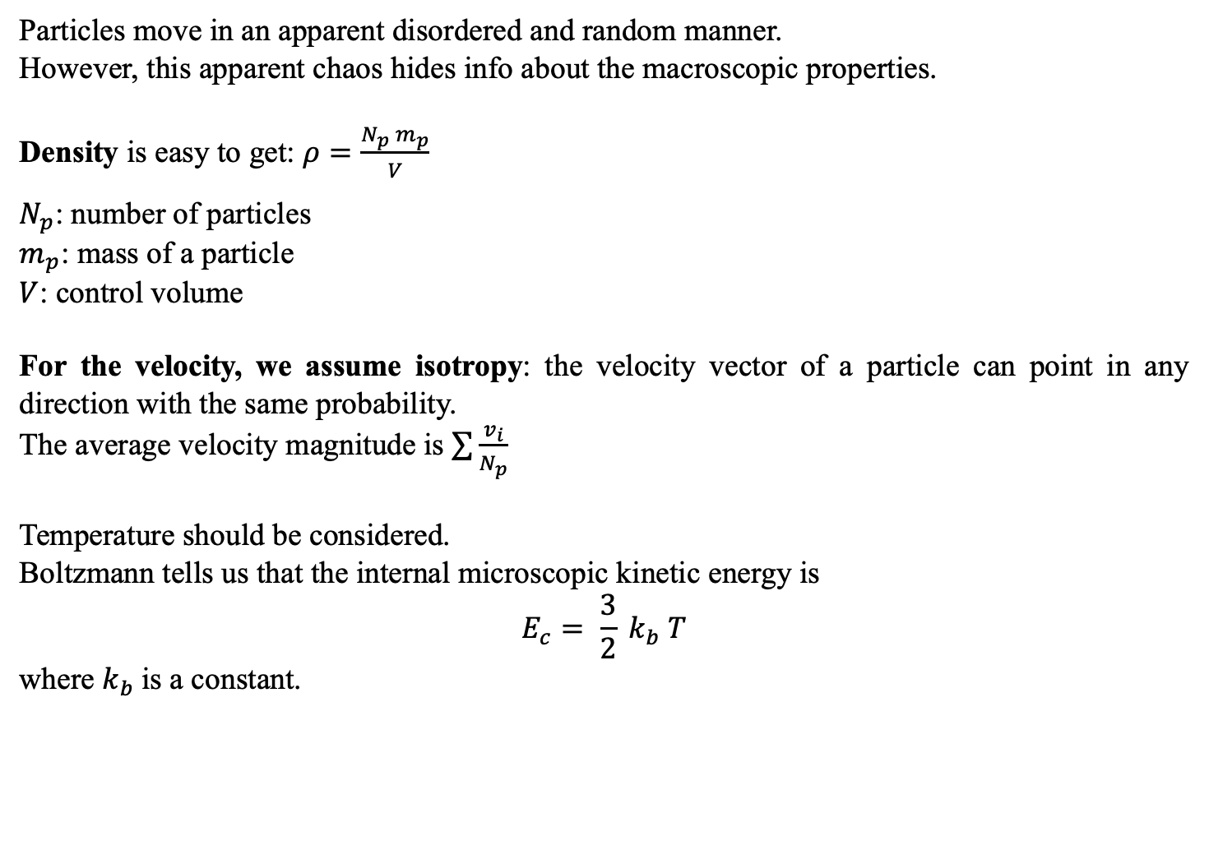
Density and velocity at the microscopic scale
9
Particles move in an apparent disordered and random manner.
However, this apparent chaos hides info about the macroscopic properties.
Density is easy to get: $ρ=\frac{N_{p} m_{p}}{V}$
$N_{p}$: number of particles
$m_{p}$: mass of a particle
$V$: control volume
For the velocity, we assume isotropy: the velocity vector of a particle can point in any direction with the same probability.
The average velocity magnitude is $\sum{\frac{v_{i}}{N_{p}}}$
Temperature should be considered.
Boltzmann tells us that the internal microscopic kinetic energy is
$$E_{c}= \frac{3}{2} k_{b} T$$
where $k_{b}$is a constant.

Slide 8
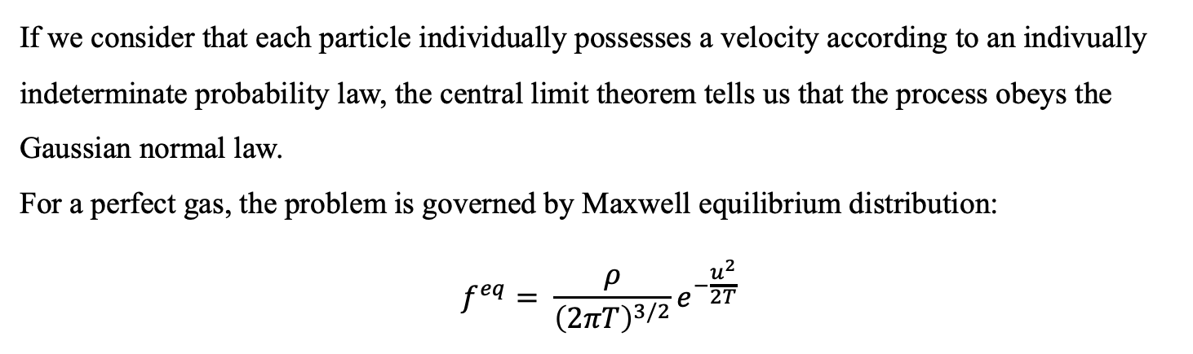
Boltzmann-Maxwell distribution of speed
10
If we consider that each particle individually possesses a velocity according to an indivually indeterminate probability law, the central limit theorem tells us that the process obeys the Gaussian normal law.
For a perfect gas, the problem is governed by Maxwell equilibrium distribution:
$$f^{eq}= \frac{ρ}{{\left(2πT\right)}^{3/2}}e^{−\frac{u^{2}}{2T}}$$

Slide 9
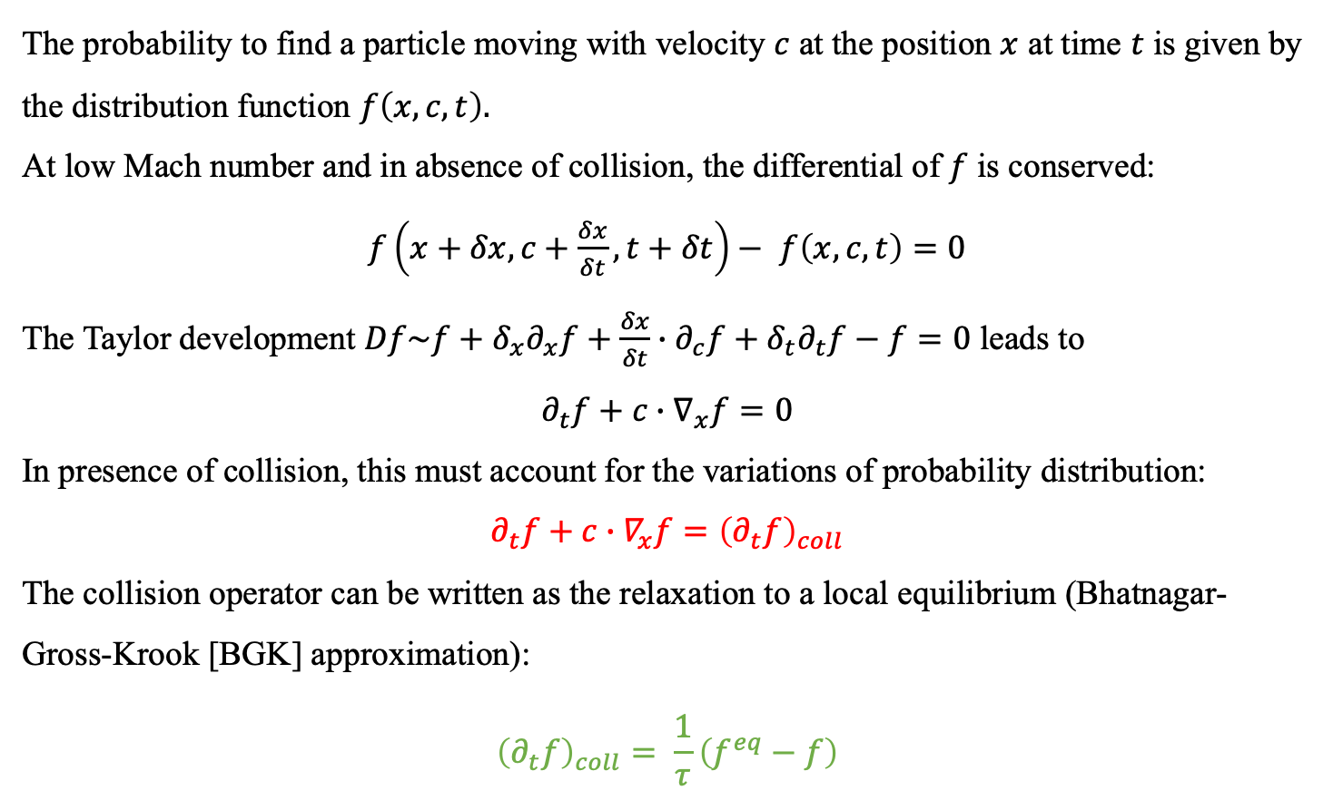
Boltzmann equation
11
The probability to find a particle moving with velocity $c$ at the position $x$ at time $t$ is given by the distribution function $f\left(x,c,t\right).$
At low Mach number and in absence of collision, the differential of $f$ is conserved:
$f\left(x+δx,c+\frac{δx}{δt},t+δt\right)−$ $f\left(x,c,t\right)=0$
The Taylor development $Df\sim f+δ_{x}∂_{x}f+\frac{δx}{δt}∙∂_{c}f+δ_{t}∂_{t}f−f=0$ leads to
$$∂_{t}f+c∙∇_{x}f=0$$
In presence of collision, this must account for the variations of probability distribution:
$$∂_{t}f+c∙∇_{x}f={\left(∂_{t}f\right)}_{coll}$$
The collision operator can be written as the relaxation to a local equilibrium (Bhatnagar-Gross-Krook [BGK] approximation):
$${\left(∂_{t}f\right)}_{coll}= \frac{1}{τ}\left(f^{eq}−f\right)$$

Slide 10
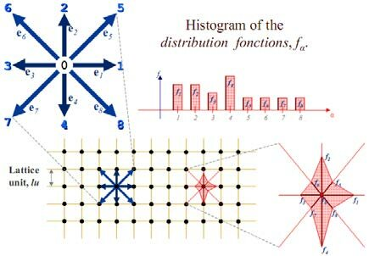
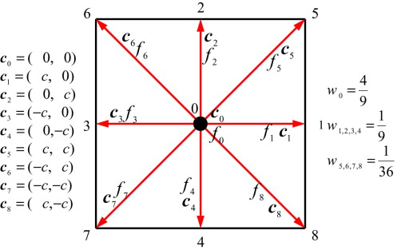
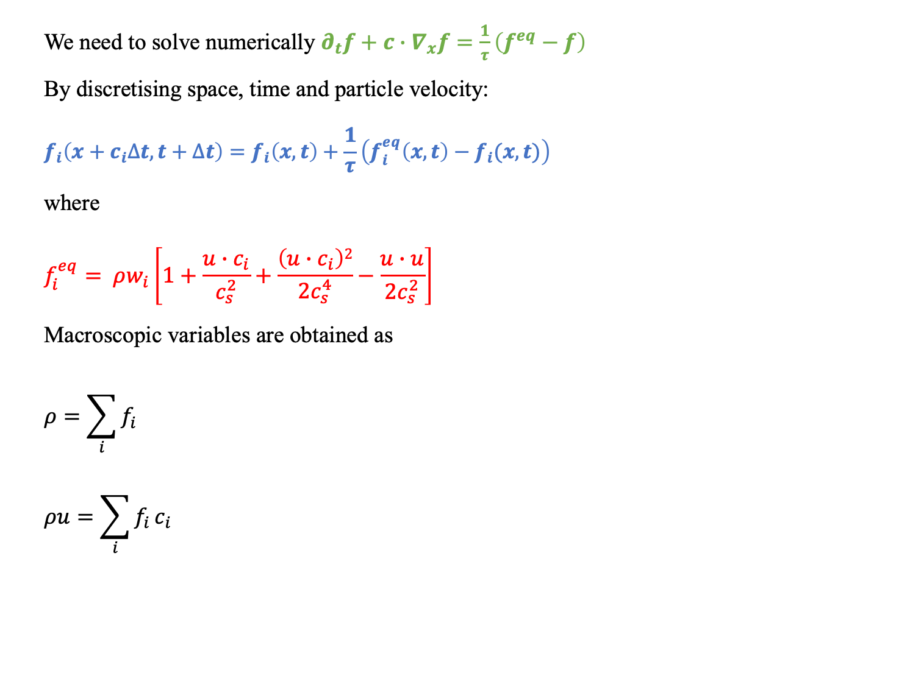
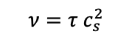
Discrete Boltzmann equation
12
We need to solve numerically $∂_{t}f+c∙∇_{x}f=\frac{1}{τ}\left(f^{eq}−f\right)$
By discretising space, time and particle velocity:
$$f_{i}\left(x+c_{i}∆t,t+∆t\right)=f_{i}\left(x,t\right)+\frac{1}{τ}\left(f_{i}^{eq}\left(x,t\right)−f_{i}(x,t)\right)$$
where
$$f_{i}^{eq}= ρw_{i}\left[1+\frac{u∙c_{i}}{c_{s}^{2}}+\frac{\left(u∙c_{i}\right)2}{{2c}_{s}^{4}}−\frac{u∙u}{2c_{s}^{2}}\right]$$
Macroscopic variables are obtained as
$$ρ=\sum_{i}{f_{i}}$$
$$ρu=\sum_{i}{f_{i}}c_{i}$$
$$ν=τ c_{s}^{2}$$
D2Q9

Slide 11
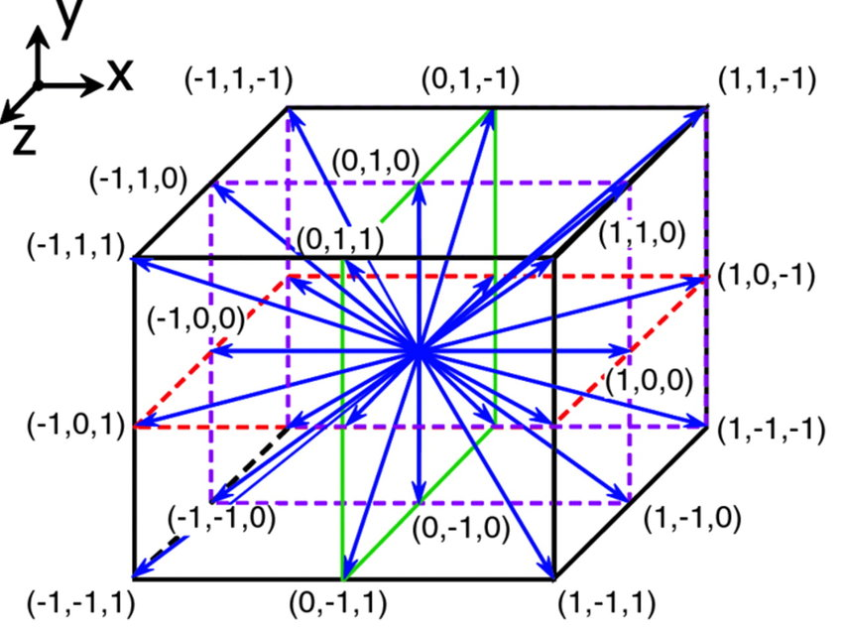
Discrete Boltzmann equation
12
We need to solve numerically $∂_{t}f+c∙∇_{x}f=\frac{1}{τ}\left(f^{eq}−f\right)$
By discretising space, time and particle velocity:
$$f_{i}\left(x+c_{i}∆t,t+∆t\right)=f_{i}\left(x,t\right)+\frac{1}{τ}\left(f_{i}^{eq}\left(x,t\right)−f_{i}(x,t)\right)$$
where
$$f_{i}^{eq}= ρw_{i}\left[1+\frac{u∙c_{i}}{c_{s}^{2}}+\frac{\left(u∙c_{i}\right)2}{{2c}_{s}^{4}}−\frac{u∙u}{2c_{s}^{2}}\right]$$
Macroscopic variables are obtained as
$$ρ=\sum_{i}{f_{i}}$$
$$ρu=\sum_{i}{f_{i}}c_{i}$$
$$ν=τ c_{s}^{2}$$
D2Q9
D3Q27

Slide 12

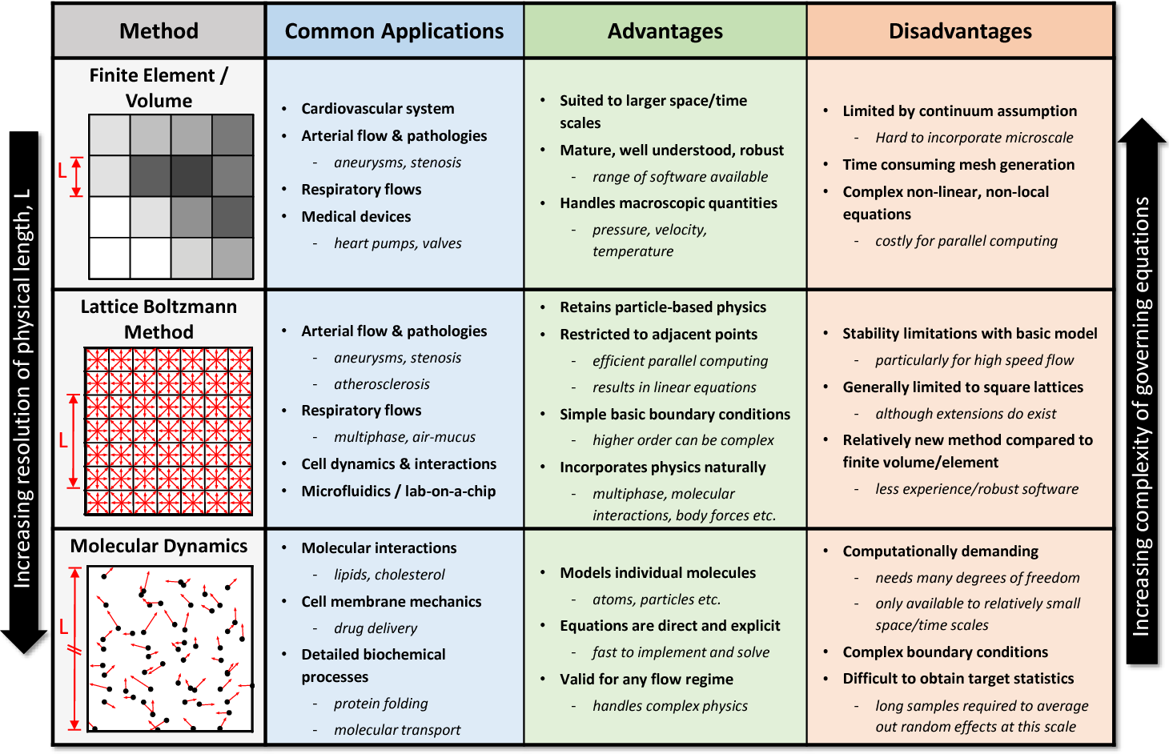








Why LBM?
13
Notes:
In addition to some popular open-source codes, during the last decade several companies have been putting a very significant amount of resources in the LBM technology. Among its advantages, it is worth to mention the intelligibility of its algorithmic procedure, the simplicity of imposing boundary conditions and the very high computational efficiency. However, the thing I like the most is its natural suitability for multiphysics.

Slide 13
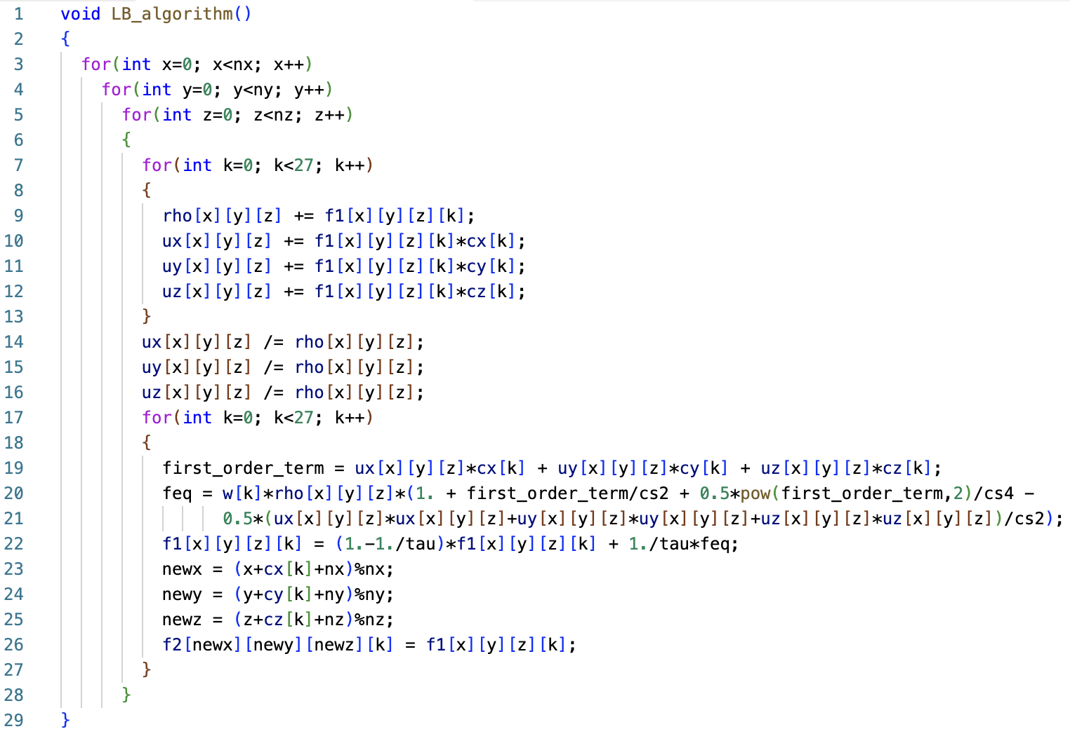
A simple (yet naive) LBM code
14

Slide 14
A simple (yet naive) LBM code
14
Grid loop

Slide 15
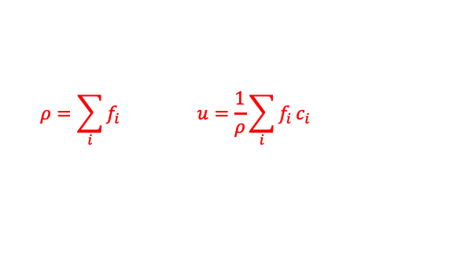
A simple (yet naive) LBM code
14
Grid loop
Compute macroscopic variables
$$ρ=\sum_{i}{f_{i}} u=\frac{1}{ρ}\sum_{i}{f_{i}}c_{i}$$

Slide 16
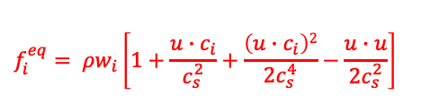
A simple (yet naive) LBM code
14
Grid loop
Compute macroscopic variables
$$ρ=\sum_{i}{f_{i}} u=\frac{1}{ρ}\sum_{i}{f_{i}}c_{i}$$
$$f_{i}^{eq}= ρw_{i}\left[1+\frac{u∙c_{i}}{c_{s}^{2}}+\frac{\left(u∙c_{i}\right)2}{{2c}_{s}^{4}}−\frac{u∙u}{2c_{s}^{2}}\right]$$
Evaluate equilibrium populations

Slide 17
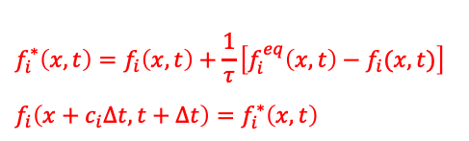
A simple (yet naive) LBM code
14
Grid loop
Compute macroscopic variables
$$ρ=\sum_{i}{f_{i}} u=\frac{1}{ρ}\sum_{i}{f_{i}}c_{i}$$
$$f_{i}^{eq}= ρw_{i}\left[1+\frac{u∙c_{i}}{c_{s}^{2}}+\frac{\left(u∙c_{i}\right)2}{{2c}_{s}^{4}}−\frac{u∙u}{2c_{s}^{2}}\right]$$
Evaluate equilibrium populations
Collision & Streaming
$$f_{i}^{∗}\left(x,t\right)=f_{i}\left(x,t\right)+\frac{1}{τ}\left[f_{i}^{eq}\left(x,t\right)−f_{i}(x,t)\right]$$
$$f_{i}\left(x+c_{i}∆t,t+∆t\right)=f_{i}^{∗}\left(x,t\right)$$

Slide 18
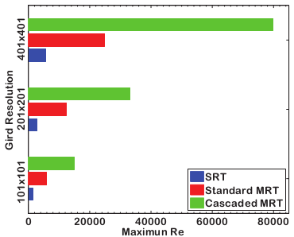
Advanced LBM for high-Re flows
21
Cascaded LBM
Geier et al. (2006) Phys Rev E
Ning et al. (2015) Int J Num Meth Fluids
Advanced LBM
Lid-driven cavity: Maximum attenaible Reynolds number
by different LB models and grid resolutions

Slide 19
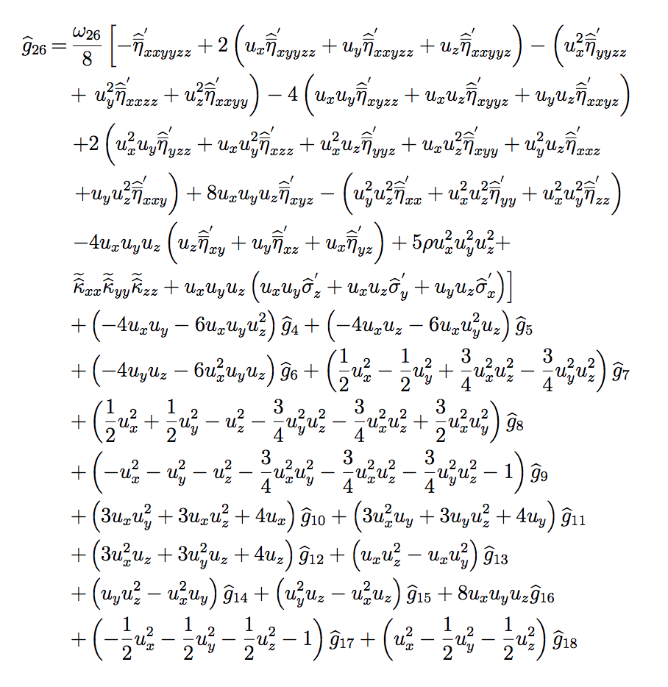
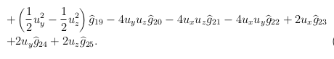
Advanced LBM for high-Re flows
21
Cascaded LBM
Geier et al. (2006) Phys Rev E
Ning et al. (2015) Int J Num Meth Fluids
Advanced LBM
Lid-driven cavity: Maximum attenaible Reynolds number
by different LB models and grid resolutions
Theory and implementation
might be cumbersome (especially in 3D…)

